Slide 1
Advanced Object Oriented Programming
Barcode Scanner
By
B V V L N BHARGAV (2110030150)
JAINA VAMSHI (2110030153)
JATIN MISHRA (2110030212)
U SAI SUBRAHMANYAM(2110030293)
Under the guidance of
FIGLU MOHANTY

Slide 2
DATA SET COLLECTION
Tuples
Why we use Tuples ?
We use Tuples for Security reasons.

Slide 3
TOOL SETUP
Eclipse
Launch4jar
Exectuable .jar files

Slide 4
TOTAL DOCUMENTATION
Implementation Flow chart
Github commits
Work progress

Slide 5
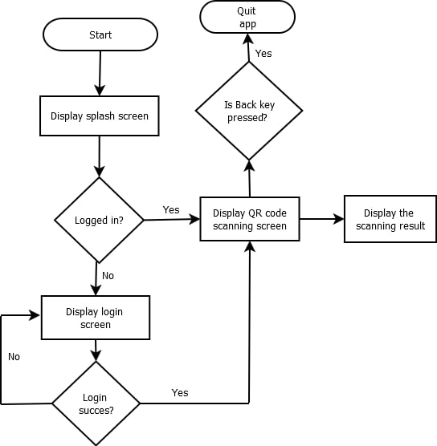
IMPLEMENTATION FLOWCHART

Slide 6
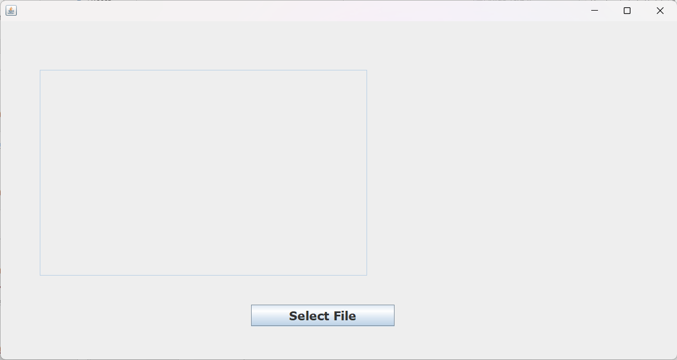
Implementation

Slide 7
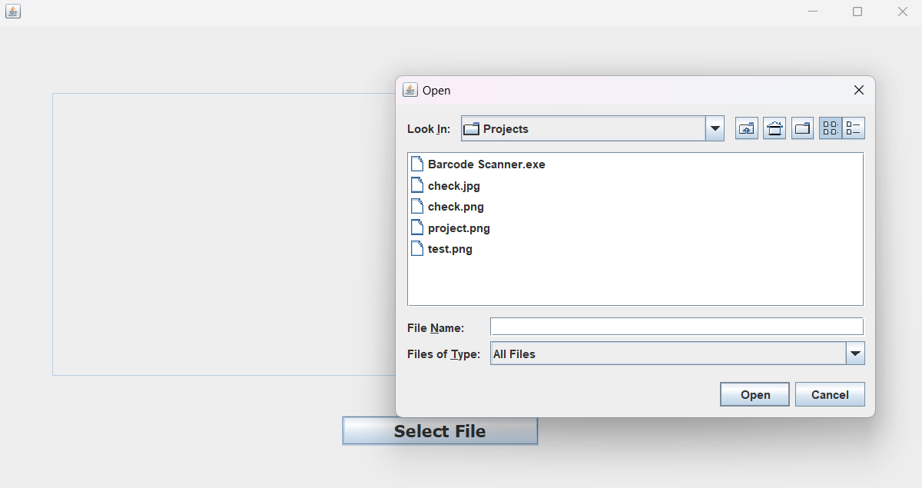
Implementation

Slide 8
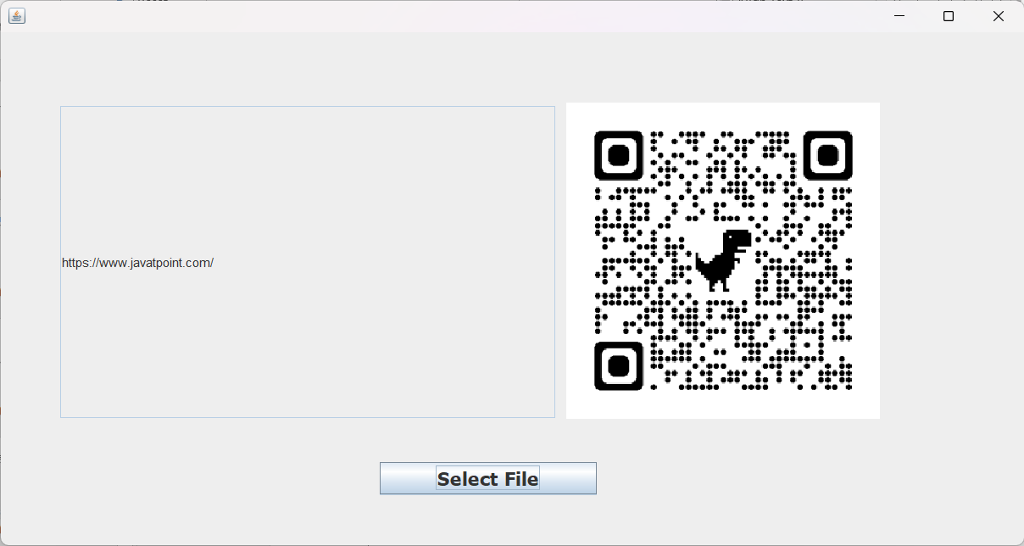
OUTPUT

Slide 9
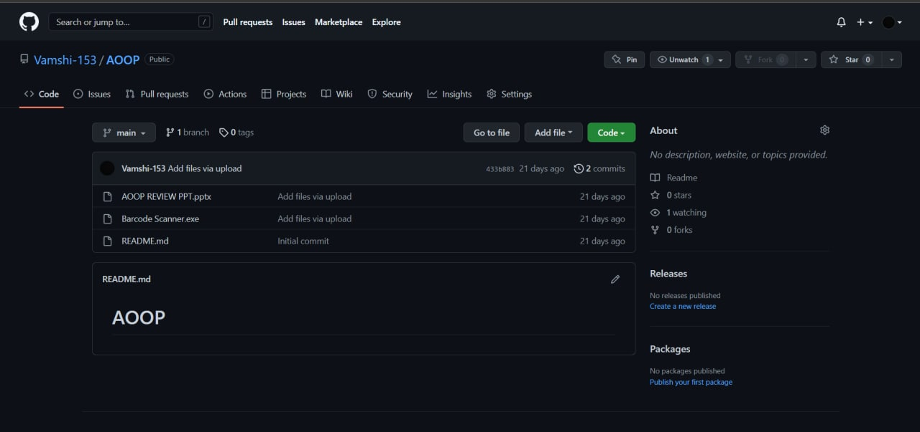
GITHUB COMMITS

Slide 10
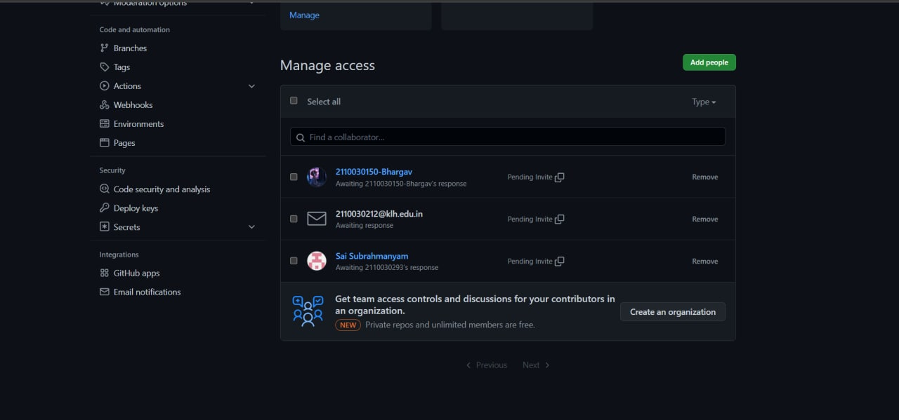

Slide 11
WORK PROGRESS
COMPLETED

